Slide 1
Introduction to Lexical Analysis
Source code
Front-End
IR
Back-End
Object code
Lexical
Analysis
Lexical Analysis:
Reads characters and produces sequences of tokens.
Today’s lecture:
Towards automated Lexical Analysis.

Slide 2
The Big Picture
First step in any translation: determine whether the text to be translated is well constructed (hence formal languages, rather than natural languages) in terms of the input language. Syntax is specified with parts of speech - syntax checking matches parts of speech against a grammar.
What does lexical analysis do?
Recognises the language’s parts of speech.

Slide 3
Language
Languages in general, consists of three components: alphabet/letters, words and sentences.
Examples:
A language L has alphabets, denoted by ∑={a, b,…, Z}
A language L has strings of words, denoted by Γ(grammer)
A language L has sentences.
In a language, the component ∑ (must be) and Γ (may be) are both finite sets, but the set of sentences can be infinite. Ex: i) You ate an apple.
ii) You ate two apples.
iii) You ate two thousand and five…
Hence, we need a finite way to define languages that may contains infinite number of words and sentences.
English | Computer Languages
Letters of alphabet | ASCII characters
Words in a dictionary | Keywords, user-defined identifiers, etc.
Sentences | Statements (e.g. assignment statement, conditional statements, etc.)
Notes:
Hence, we need a finite way to define languages that may contains infinite number of words and sentences.

Slide 4
In a formal language:
Alphabet is a finite set of symbols.
A string is any finite sequence of symbols from alphabet.
A grammar is a finite way of describing a language.
A (e.g. context-free) grammar, G, is a 4-tuple, G=(S,V,T,P), where:
S: starting symbol
V: set of non-terminal symbols, or variables
T: set of terminal symbols
P: set of production rules
A language is the set of all productions of G.
Example: Identifying numbers, we may write the grammar as
G= (S, V, T, P) in which V: {N, D, F};
T: {., 0, 1, 2,…, 9}
P: { N→ DN | NFN | D
D→ 0 | 1 | 2 | … | 9}

Slide 5
Tokens, Lexemes, Patterns
Tokens
Token is a sequence of characters. Tokens may be
a) Identifiers b) Keywords c) Operator d) Special Symbols c) Constant, and so on.
Lexemes
Lexeme is sequence of characters are matched by a pattern (i.e. RE) for token.
Patterns
Rule of description is a pattern. Patterns are specified using regular expression.
Ex: letter(letter | digit)*

Slide 6
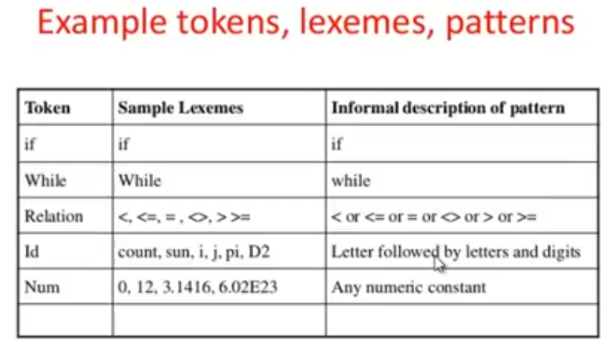
Tokens, Lexemes, Patterns

Slide 7
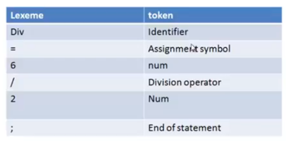
Tokenization
Process of forming tokens from input stream (lexemes) is called tokenization.
Ex: div = 6/2;

Slide 8
What is attribute for token
Lexical analyzer provides additional information about particular lexeme.
Ex: y = 4*x + 5;
Token stream should be:
<id, y><op,=><num,4><id, x><op,+><num,5>

Slide 9
Why all this?
Why study lexical analysis?
To avoid writing lexical analysers (scanners) by hand.
To simplify specification and implementation.
To understand the underlying techniques and technologies.
We want to specify lexical patterns (to derive tokens):
Some parts are easy:
WhiteSpace → blank | tab | WhiteSpace blank | WhiteSpace tab
Keywords and operators (if, then, =, +)
Comments (/* followed by */ in C, // in C++, % in latex, ...)
Some parts are more complex:
Identifiers (letter followed by - up to n - alphanumerics…)
Numbers
We need a notation that could lead to an implementation!

Slide 10
Building a Lexical Analyser by hand
Based on the specifications of tokens through regular expressions we can write a lexical analyser. One approach is to check case by case and split into smaller problems that can be solved ad hoc. Example:
void get_next_token() {
c=input_char();
if (is_eof(c)) { token ← (EOF,”eof”); return}
if (is_letter(c)) {recognise_id()}
else if (is_digit(c)) {recognise_number()}
else if (is_operator(c))||is_separator(c))
{token ← (c,c)} //single char assumed
else {token ← (ERROR,c)}
return;
}
...
do {
get_next_token();
print(token.class, token.attribute);
} while (token.class != EOF);
Can be efficient; but requires a lot of work and may be difficult to modify!

Slide 11
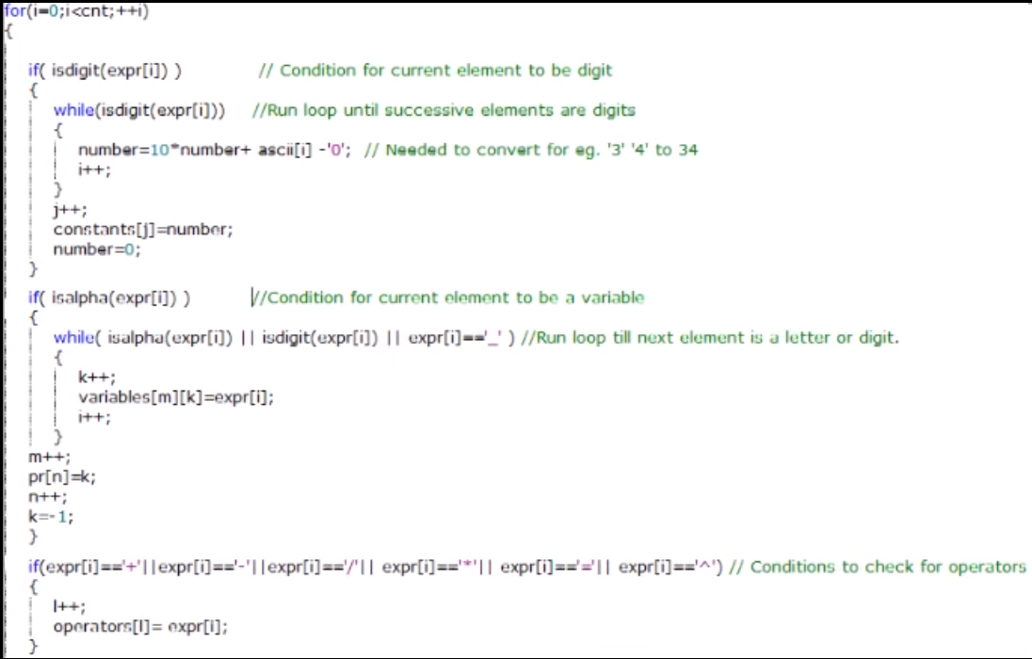
-------------------------------------------------------------------------

Slide 12
Building lexical analyser by hand can be efficient; but requires a lot of work and may be difficult to modify!
Hence the suitable approach is:
Building Lexical Analysers “automatically”

Slide 13
Regular Expressions
Patterns form a regular language. A regular expression is a way of specifying a regular language. It is a formula that describes a possibly infinite set of strings.
Regular Expression (RE) (over alphabet Σ):
ε is a RE denoting the empty set {ε}.
If a ∈ Σ then a is a RE denoting {a}.
If r₁, r₂ are REs then:
r₁* denotes zero or more occurrences of r₁;
r₁r₂ denotes concatenation;
r₁ | r₂ denotes either r₁ or r₂;
Describe the languages denoted by the following REs
a; a | b; a*;

Slide 14
Regular Expression
Complex REs can be constructed from the basic constructs (pre-emptive RE):
(a | b)*; (a | b)(a | b); (a*b*)*; (a | b)*baa;
Decimal → Integer.(0 | 1 | 2 | … | 9)*
Identifier→ [a-zA-Z] [a-zA-Z0-9]*
Shorthands: [a-d] for a | b | c | d; r⁺ for rr*; r? for r | ε
(Not all languages can be described by regular expressions. But, we don’t care for now).

Slide 15
We study REs to automate scanner construction!
Consider the problem of recognising register names starting with r and requiring at least one digit:
Register → r (0|1|2|…|9) (0|1|2|…|9)* (or, Register → r Digit Digit*)
The RE corresponds to a transition diagram:
digit
start
S₀
r
S₁
digit
S₂
Depicts the actions that take place in the scanner.
• A circle represents a state; S0: start state; S2: final state (double circle)
• An arrow represents a transition; the label specifies the cause of the transition.
A string is accepted if, going through the transitions, ends in a final state (for example, r345, r0, r29, as opposed to a, r, rab)

Slide 16
Towards Automation (finally!)
An easy (computerised) implementation of a transition diagram is a transition table: a column for each input symbol and a row for each state. An entry is a set of states that can be reached from a state on some input symbol. E.g.:
Input
state ‘r’ digit
S0 S1 -
S1 - S2
S2(final) - S2
If we know the transition table and the final state(s) we can build directly a recogniser that detects acceptance:
char=input_char();
state=0; // starting state
while (char != EOF) {
state ← table(state,char);
if (state == ‘-’) return failure;
word=word+char;
char=input_char();
}
if (state == FINAL) return acceptance; else return failure;

Slide 17
A Modified Example (recognise r0 through r31) Register → r ((0|1|2) (Digit|ε) | (4|5|6|7|8|9) | (3|30|31))
digit
S₂
S₃
0|1|2
r
3
0|1
S₀
S₁
S₅
S₆
4|5|6|7|8|9
S₄
State ‘r’ 0,1 2 3 4,5,…,9
0 1 - - - -
1 - 2 2 5 4
2(final) - 3 3 3 3
3(final) - - - - -
4(final) - - - - -
5(final) - 6 - - -
6(final) - - - - -

Slide 18
Finite Automata (FA)/FSA
Finite set of states
is in exactly one state at a time
CONTROL
UNIT
Start state
Final state(s)
TAPE
HEAD
Move to the right one cell at a time
INPUT TAPE
Store input of the FA
Can be of any length
Notes:
How does an FA work?
At the beginning,
-an FA is in the start state (initial state)
-its tape head points at the first cell
For each move, FA
-reads the symbol under its tape head
-changes its state (according to the transition function) to the next state determined by the symbol read from the tape and its current state
-move its tape head to the right one cell

Slide 19
Finite Automata
The generalised transition diagram is a FA. It can be:
Deterministic, DFA; as in the example
Non-Deterministic, NFA; more than 1 transition out of a state may be possible on the same input symbol: think about: (a | b)* abb
ε-NFA or NFA with ε-transition.
Every regular expression can be converted to a DFA!

Slide 20
Scanner Generator: Full Story!
So far it has been showed that the lexical structure of tokens could be specified by RE and that from RE we could automatically construct a lexical analyzer to recognize the tokens.
Automatic Lexical Analyser Construction:
Write down the RE for the input language.
Convert the RE to a ε-NFA (Thompson’s construction)
Convert ε-NFA to NFA (Applying ε-Closure)
Build the DFA that simulates the NFA (subset construction)
Shrink the DFA (Hopcroft’s algorithm)
Notes:
Describing tokens by means of how (e.g. regular expression) they can be recognized (or accepted) is often done in terms of a mathematical model, known as finite-state acceptor (FSA) or FA.
Using a set of REs and associated actions (segments of code that dictate the tasks associated with REs, scanner generator (Lex, Flex, Bison) creates a scanner. Ex, Lex generates a transition table and a program which interprets the tables. An action is executed whenever a token is executed.
Thus, the output from Lex is a program simulates a FSA and performs the additional functions which are associated with the final states of acceptor. The scanner generated by Lex can be used in conjunction with a parser generator for the lexical and syntactic phases of compilation.

Slide 21
Scanner Generator: Summery!
Describing tokens by means of how (e.g. regular expression) they can be recognized (or accepted) is often done in terms of a mathematical model, known as finite-state acceptor (FSA) or FA.
Regular Expressions (REs) are formulae to describe a (regular) language.
Every RE can be converted to a Deterministic Finite Automaton (DFA).
DFAs can automate the construction of lexical analysers.
Scanner generator creates a scanner that uses RE as input. One kind of scanner generator is Lex! (or Flex for windows)
Using a set of REs and associated segments of code called “actions” (which dictate the tasks associated with expression and executed whenever a token is recognized), Lex generates a transition table and a program which interprets the tables.
Thus the output from the Lex is a program which simulates a FA or more general lexical analyzer! [
Bison is similar to Lex but for parser!
Notes:
Describing tokens by means of how (e.g. regular expression) can be recognized (or accepted) is often done in terms of a mathematical model, known as finite-state acceptor (FSA) or FA.

Slide 22


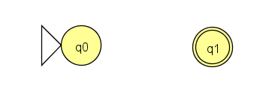
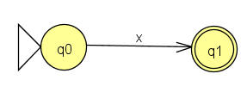

RE to ε-NFA using Thompson’s construction
The three fundamental regular expressions, such as ε, $∅$, and x, where x$∈Σ$, are represented in transitions diagrams as:
Or

Slide 23
RE to ε-NFA using Thompson’s construction
Using the aforementioned fundamental simple diagrams, more complex FSA can be constructed for regular expression using the operations of alternation, concatenation and closure.
a
b
S₀
S₁
S₀
S₁
NFA for a
NFA for b
a
ε
b
S₀
S₁
S₂
S₃
a
S₁
S₂
ε
NFA for ab
ε
S₅
ε
S₀
b
ε
ε
ε
ε
S₃
S₄
S₀
S₁
a
S₂
S₃
NFA for a | b
ε
NFA for a*

Slide 24
Example: Construct the NFA of a (b|c)*
a
First: NFAs
for a, b, c
a
b
c
S₀
S₀
S₁
S₀
S₁
S₁
S₀
S₁
b
b
ε
S₁
S₂
ε
S₂
S₃
ε
ε
ε
S₅
ε
ε
S₀
S₀
S₁
S₆
S₇
ε
ε
c
ε
ε
c
S₃
S₄
S₄
S₅
ε
Second: NFA for b|c
Third: NFA for (b|c)*
Fourth: NFA
for a(b|c)*
ε
Of course, a human
would design a simpler one… But, we can automate production of the complex one...
b
S₄
S₅
ε
ε
a
ε
ε
ε
S₀
S₁
S₂
S₃
S₈
S₉
ε
ε
c
b | c
S₆
S₇
a
ε
S₀
S₁

Slide 25
ε-NFA to DFA: two key functions
move(s_{i},a): the (union of the) set of states to which there is a transition on input symbol a from state s_{i}
ε-closure(s_{i}): the (union of the) set of states reachable by ε from s_{i}.
Example (see the diagram below):
ε-closure(3)={3,4,7}; ε-closure({3,10})={3,4,7,10};
move(ε-closure({3,10}),a)=8;
10
ε
ε
a
4
7
8
3
ε
The Algorithm:
start with the ε-closure of s₀ from NFA.
Do for each unmarked state until there are no unmarked states:
for each symbol take their ε-closure(move(state,symbol))

Slide 26
NFA to DFA with subset construction
Initially, ε-closure is the only state in Dstates and it is unmarked.
while there is an unmarked state T in Dstates
mark T
for each input symbol a
U:=ε-closure(move(T,a))
if U is not in Dstates then add U as unmarked to Dstates
Dtable[T,a]:=U
Dstates (set of states for DFA) and Dtable form the DFA.
Each state of DFA corresponds to a set of NFA states that NFA could be in after reading some sequences of input symbols.
This is a fixed-point computation.
It sounds more complex than it actually is!

Slide 27
Example: NFA for (a | b)*abb
ε
a
2
3
ε
ε
ε
ε
a
b
b
0
1
6
7
8
9
10
ε
ε
b
ε
4
5
A=ε-closure(0)={0,1,2,4,7}
for each input symbol (that is, a and b):
B=ε-closure(move(A,a))=ε-closure({3,8})={1,2,3,4,6,7,8}
C=ε-closure(move(A,b))=ε-closure({5})={1,2,4,5,6,7}
Dtable[A,a]=B; Dtable[A,b]=C
B and C are unmarked. Repeating the above we end up with:
C={1,2,4,5,6,7}; D={1,2,4,5,6,7,9}; E={1,2,4,5,6,7,10}; and
Dtable[B,a]=B; Dtable[B,b]=D; Dtable[C,a]=B; Dtable[C,b]=C; Dtable[D,a]=B; Dtable[D,b]=E; Dtable[E,a]=B; Dtable[E,b]=C; no more unmarked sets at this point!

Slide 28
Result of applying subset construction
Transition table:
state a b
A B C
B B D
C B C
D B E
E(final) B C
b
C
b
b
a
A
D
E
a
b
b
B
a
a
a

Slide 29
Another NFA version of the same RE
a|b
ε
a
b
b
N0
N1
N2
N3
N4
Apply the subset construction algorithm:
Note:
iteration 3 adds nothing new, so the algorithm stops.
state E contains N4 (final state)

Slide 30
Enough theory… Let’s conclude!
We presented algorithms to construct a DFA from a RE.
The DFA is not necessarily the smallest possible.
Using an (automatically generated) transition table and the standard code skeleton (Lecture 3, slide 11) we can build a lexical analyser from regular expressions automatically. But, the size of the table can be large...
Next time:
DFA minimisation; Practical considerations; Lexical Analysis wrap-up.
Reading: Aho2 Sections 3.6-3.7; Aho1 pp. 113-125; Grune 2.1.6.1-2.1.6.6 (different style); Hunter 3.3 (very condensed); Cooper1 2.4-2.4.3

Slide 31
Assignments
1. Write a C program that read the following string:
“ Md. Tareq Zaman, Part-3, 2011”
a) Count number of words, letters, digits and other characters.
b) Separates letters, digits and others characters.
2. Write a program that read the following string:
“ Munmun is the student of Computer Science & Engineering”.
a) Count how many vowels and Consonants are there?
b) Find out which vowels and consonants are existed in the above string?
c) Divide the given string into two separate strings, where one string only contains the words started with vowel, and another contains the words started with consonant.
3. Write a program that abbreviates the following code:
CSE-3141 as Computer Science & Engineering, 3rd year, 1st semester, Compiler Design, Theory.

